Slide 1
Algorithm & C programming

Slide 2
Algorithm & C programming
Content
Introduction to algorithm
Be able to know solving problems step by step
Be able to know what is variable?
Introduction to C programming

Slide 3
Algorithm
What is algorithm?
Algorithm is the step-by-step procedure that can help to solve a given problem or reach a goal.
To reach a certain goal, algorithm need input, process, output. We can think it as a cooking process.
An algorithm is not a programming language, it just written in simple English that allow other programmer to understand the process the specific code.
To make computer understand and solve a problem , we need to convert algorithm to specific programming language.
Example: C/C++,Python,Java, etc.
Input
Process
Output/result

Slide 4
Algorithm
Example: Add 2 numbers(specific to coding)
Step1: start
Step2: declare the three variables (a,b,c)
Step3: defined the values for a and b
Step4: add the value of a and b
Step5: stored result in variable c
Step6: display c
Step7: stop.
input
Processing input
Display the result or output

Slide 5
Algorithm
Why do we need to learn algorithm?
It give us idea how to deal with a given problem.
Analyses the problem and solve it step-by-step.
A problem can be solve by one or more algorithms.
Important guidelines
Clarity
1.Semantic : Meaning
2.Syntactic : Grammar {“”, ; , ( ) , ‘ ’}
Want to make
Fruit Salad
output
Ice Latte

Slide 6
Variable
Variable is used to store value and its value can be changed while the programing run.
Why do we need variable?
Example:coefficient of 2
X1=1*2
X2=2*2
X3=3*2
…….
Mul=2
X1=1*Mul
X2=2*Mul
X3=3*Mul
……
What is the multiplier is change to 3?
You will need to change 3 times or more .
What if the multiplier is change to 3?
=> You just need to update value of Mul to 3.

Slide 7
Variable
Basic types of variable:
Number:
Integer:Not include non-fractional number , (e.g: 3 , 5 ,..)
Float:Non-fractional and fractional number,(e.g: 4 , 4.5 ,..)
Character: A single letter that write inside a single quote,e.g: ‘T’, ‘M’ , …
Sequence of character: A string (a set of letters) that write inside double quote,e.g: “A”, “Monday” , …
Naming a variable:
Start with a small or capital letter(e.g:age,Age) or underscore (e.g:_tel )
Not start with number or any symbol (+,-,@,#,….)
No space is allowed.
If the name is long , use underscore (Student_ID) or camel case (myEmail)

Slide 8
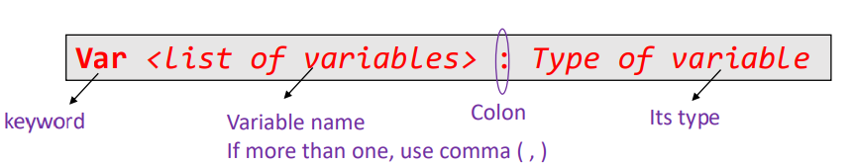
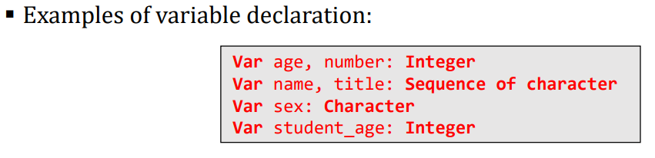
Variable
Naming convention(good practice)
Name of a variable should reflect the value it will store
The name should be readable and not too short
How to create a variable?
A variable is created by variable declaration
We declare a variable in order to reserve memory space for it .
Declaring a variable:

Slide 9
C programming
#include<stdio.h>
Int main(){
printf(“Welcome to summer online training 2020!\n”);
printf(“Welcome to C programing”);
}

Slide 10
C programming
In C programming language, file extension is .c . E.g : (Test.c)
Before starting out in C programing, we need a compiler . A compiler converts code in an executable file that computer can understand and run
A software that provide supports to programmer to develop software is called IDE (integrated development environment)
Code::Blocks will be used
Other: Atom, Visual Studio Code ,…
Writing a comment
You can write a comment/ note inside your code for explaining yourself or other
There are two types of comment
// your comment : single comment ( put after // )
/* your comment */ : multiple comment ( put inside /* */ )

Slide 11
C programming
In C programming, all statement begin inside main function:
main().
When first execute the program, the main function is always called.
Header is needed in order to access the library that include with compiler. (#include<stdio.h>,#include<math.h>,… must be include on top )
#include<stdio.h>
int main(){
printf(“Welcome to summer online training 2020!\n”);
printf(“Welcome to C programing”);
}
header
Main function
.use {} : code inside belong to main
Semicolon
To tell end line of code
Block of code/Statement

Slide 12
C programming
Create a variable:Type of variable < variable name >
int a , b , c ; // Integer
char ch ; // Character
float price ; // Decimal number
char name[10] ; // String ( sequence of character)
Display variable value printf(“ placeholder ”,<variable name>):
%d // type integer
%c // type character
%f // type float
%s // type string
Note: display special character use double quote “ ”, and “\n” use for start new line and “\t” use for tab.

Slide 13
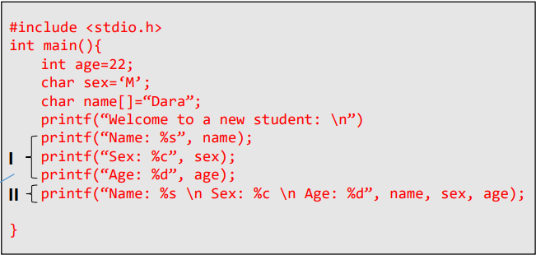

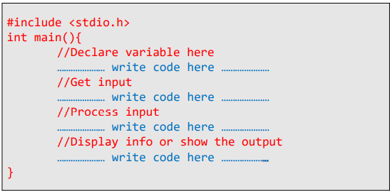
C programming
Example
Structure

Slide 14
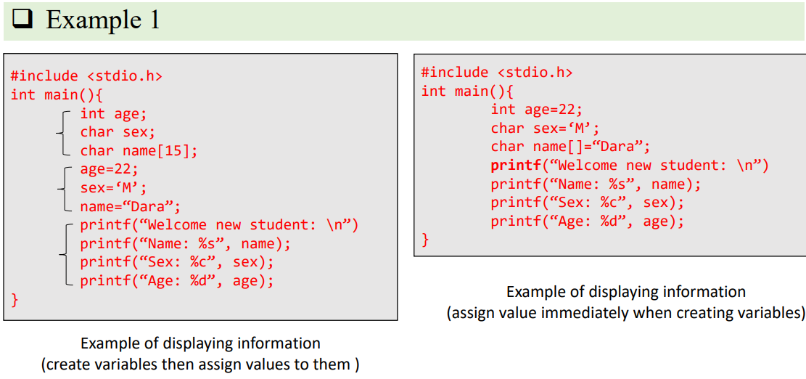
C programming

Slide 15
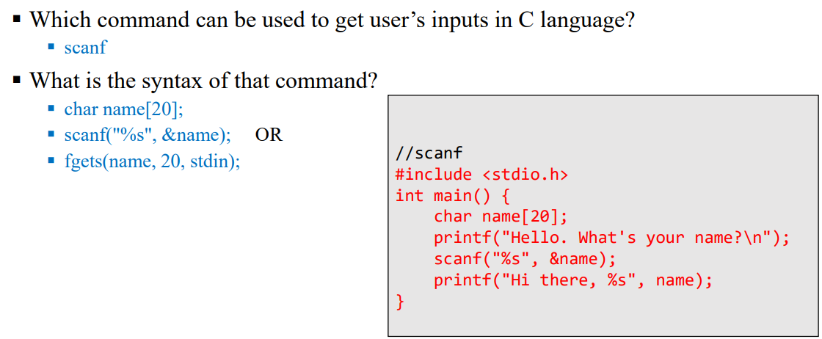
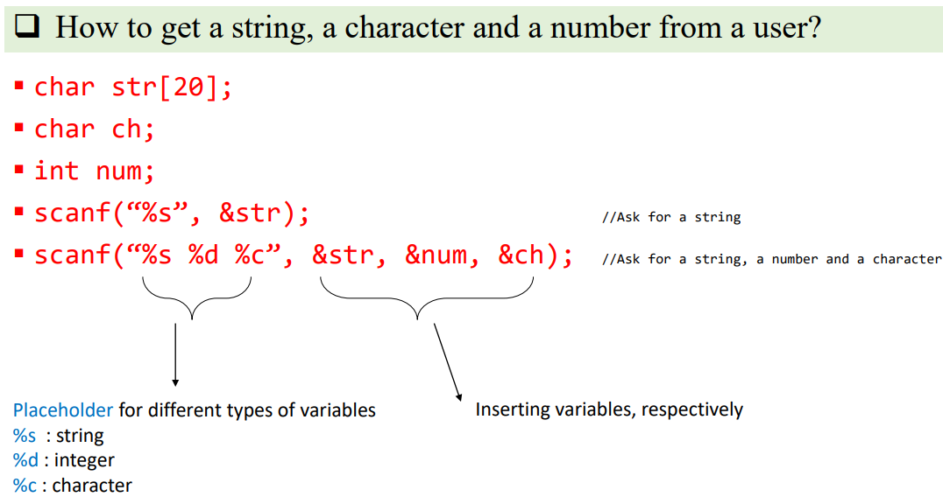
C programming
How to get user’s inputs?

